Slide 1
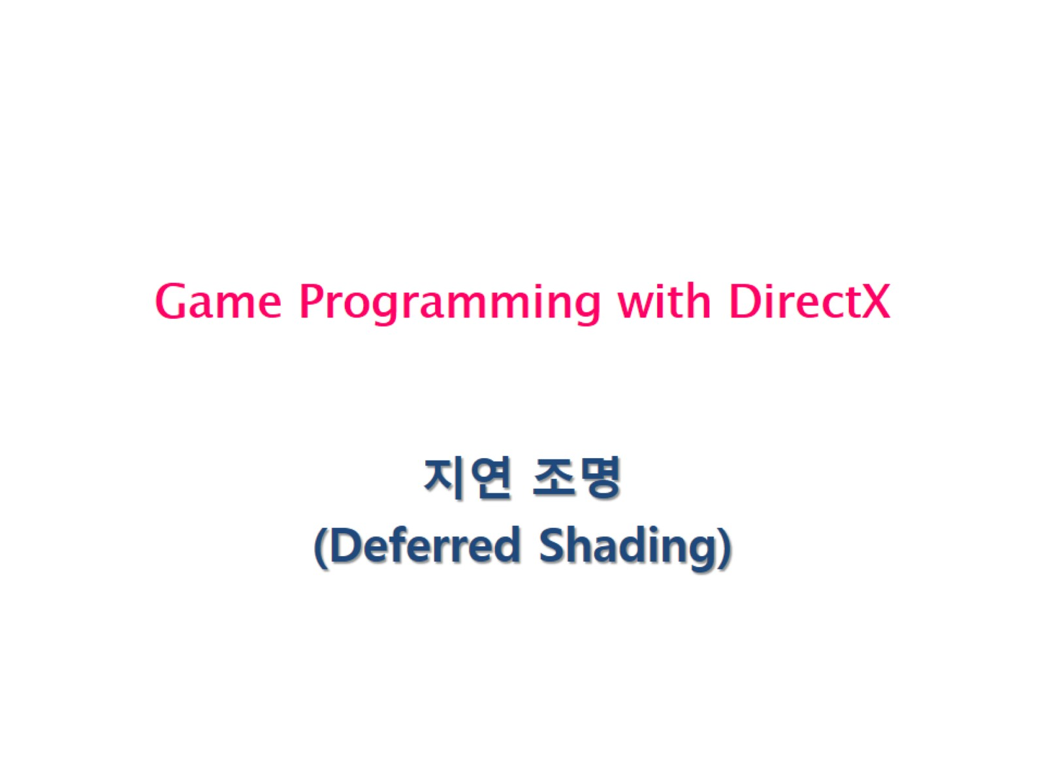
Game Programming with DirectX

Slide 2
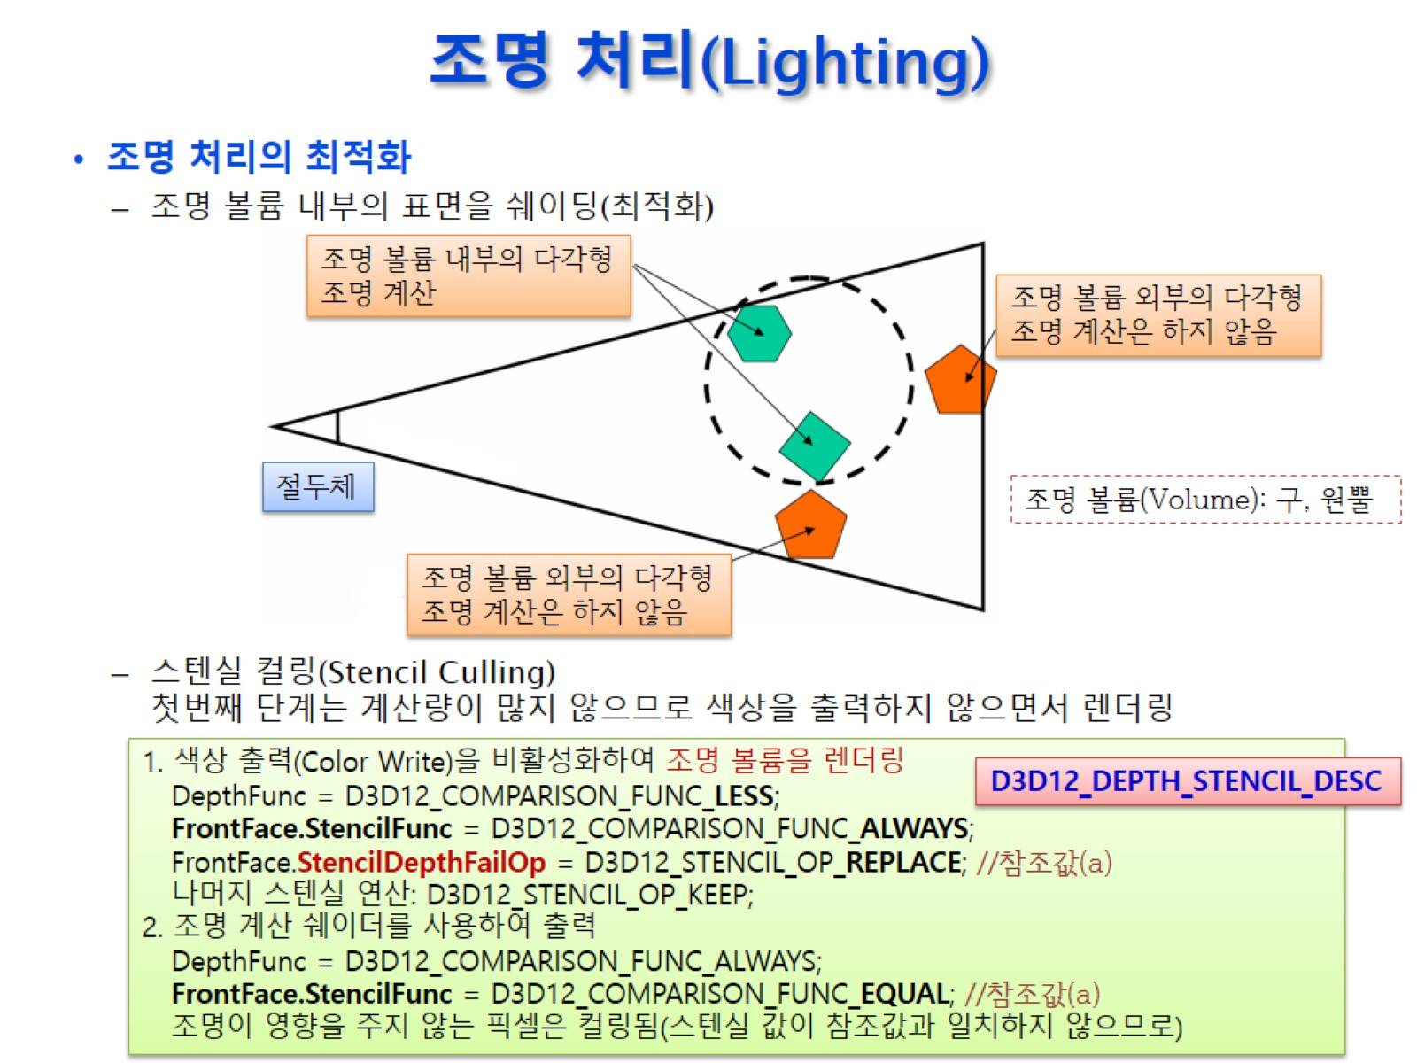
조명 처리(Lighting)

Slide 3
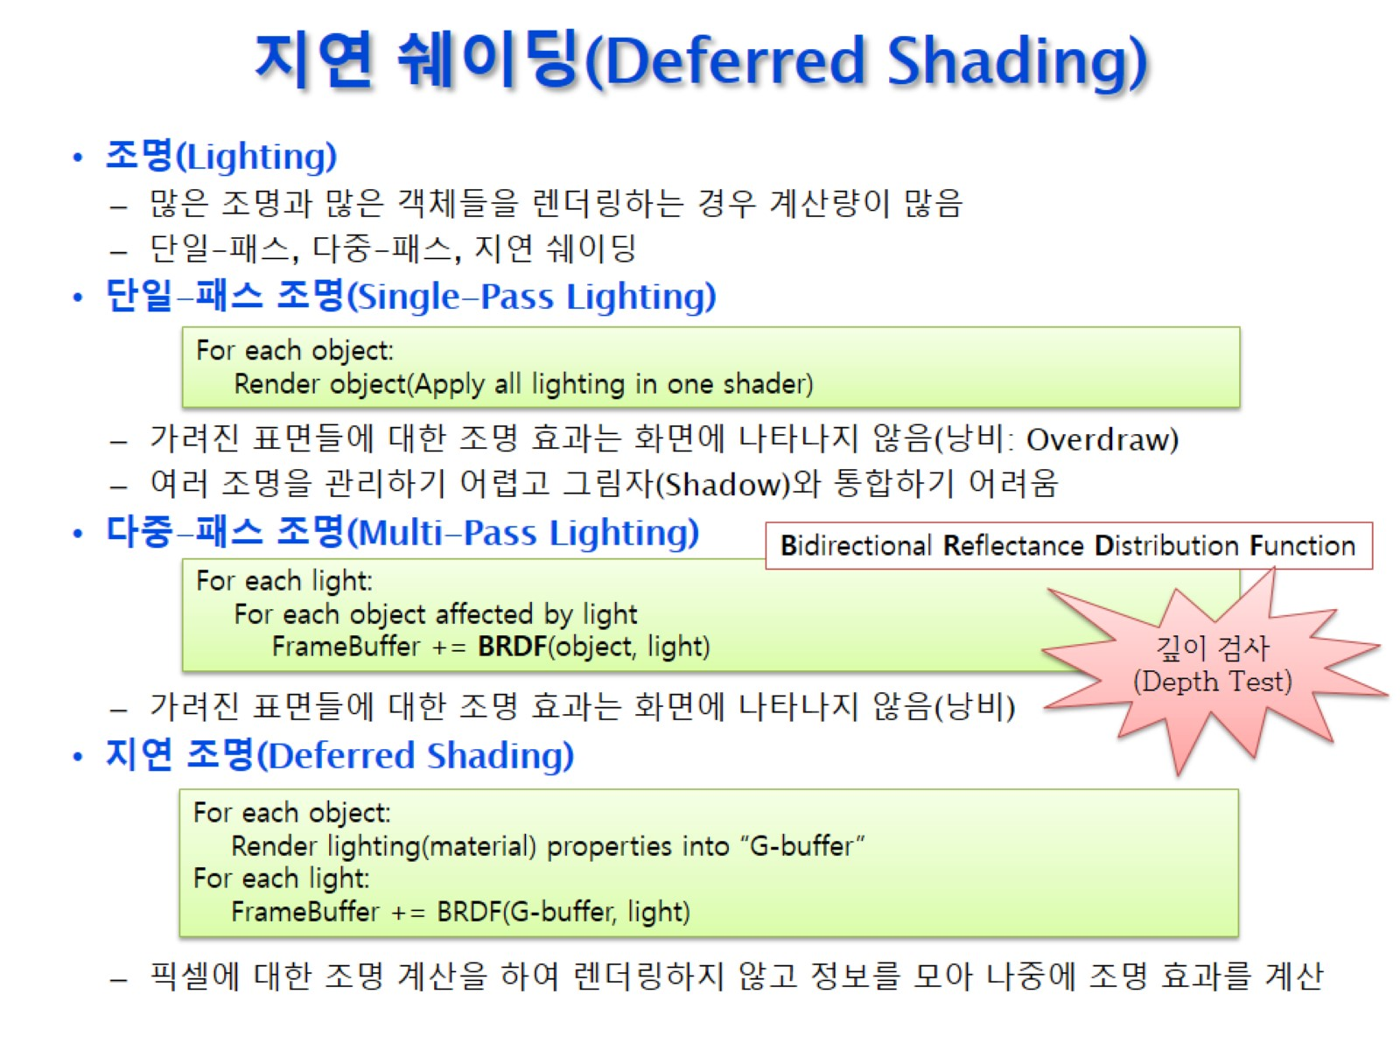
지연 쉐이딩(Deferred Shading)

Slide 4
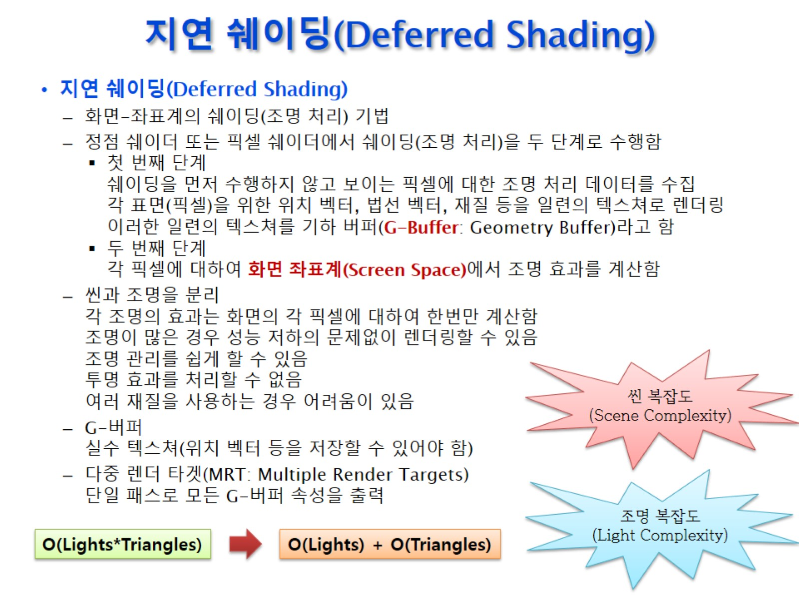
지연 쉐이딩(Deferred Shading)

Slide 5
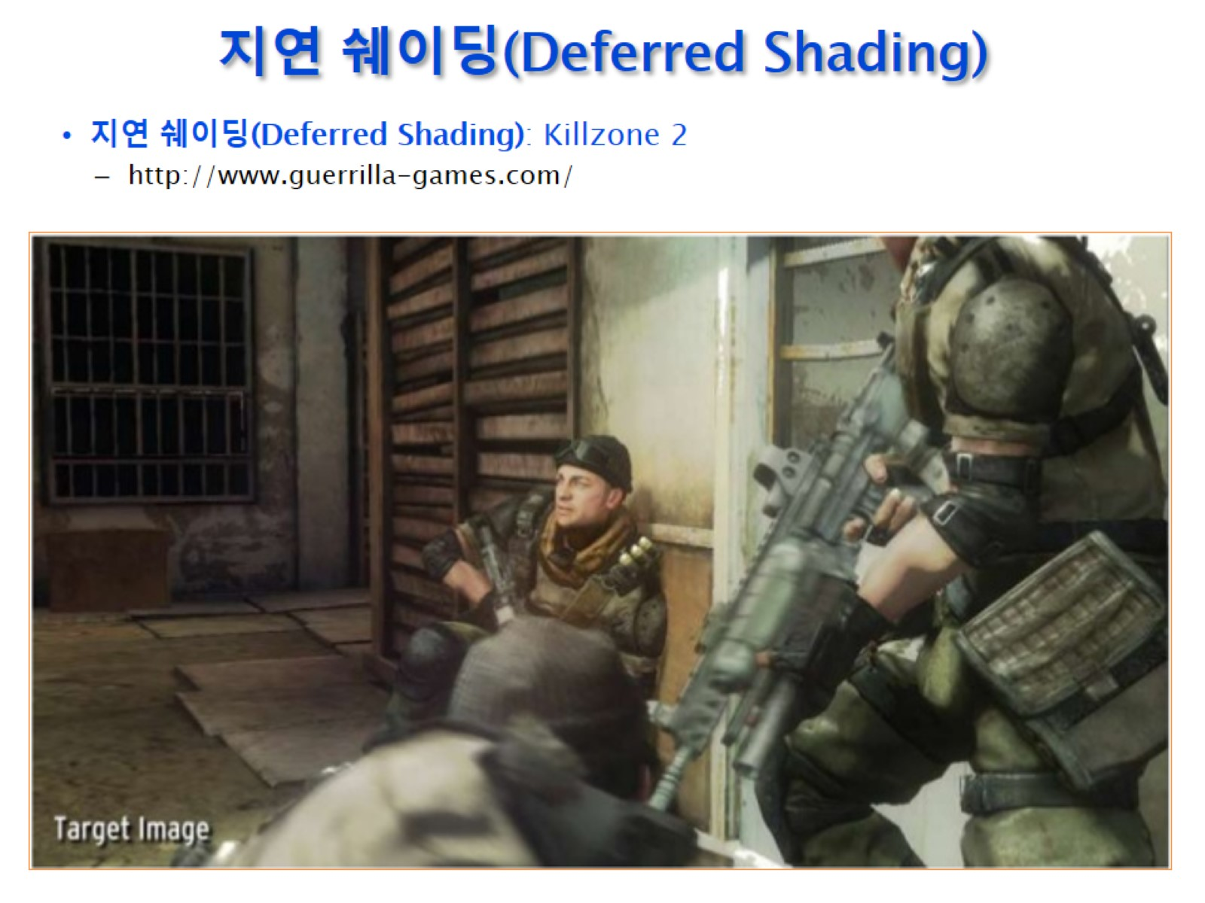
지연 쉐이딩(Deferred Shading)

Slide 6
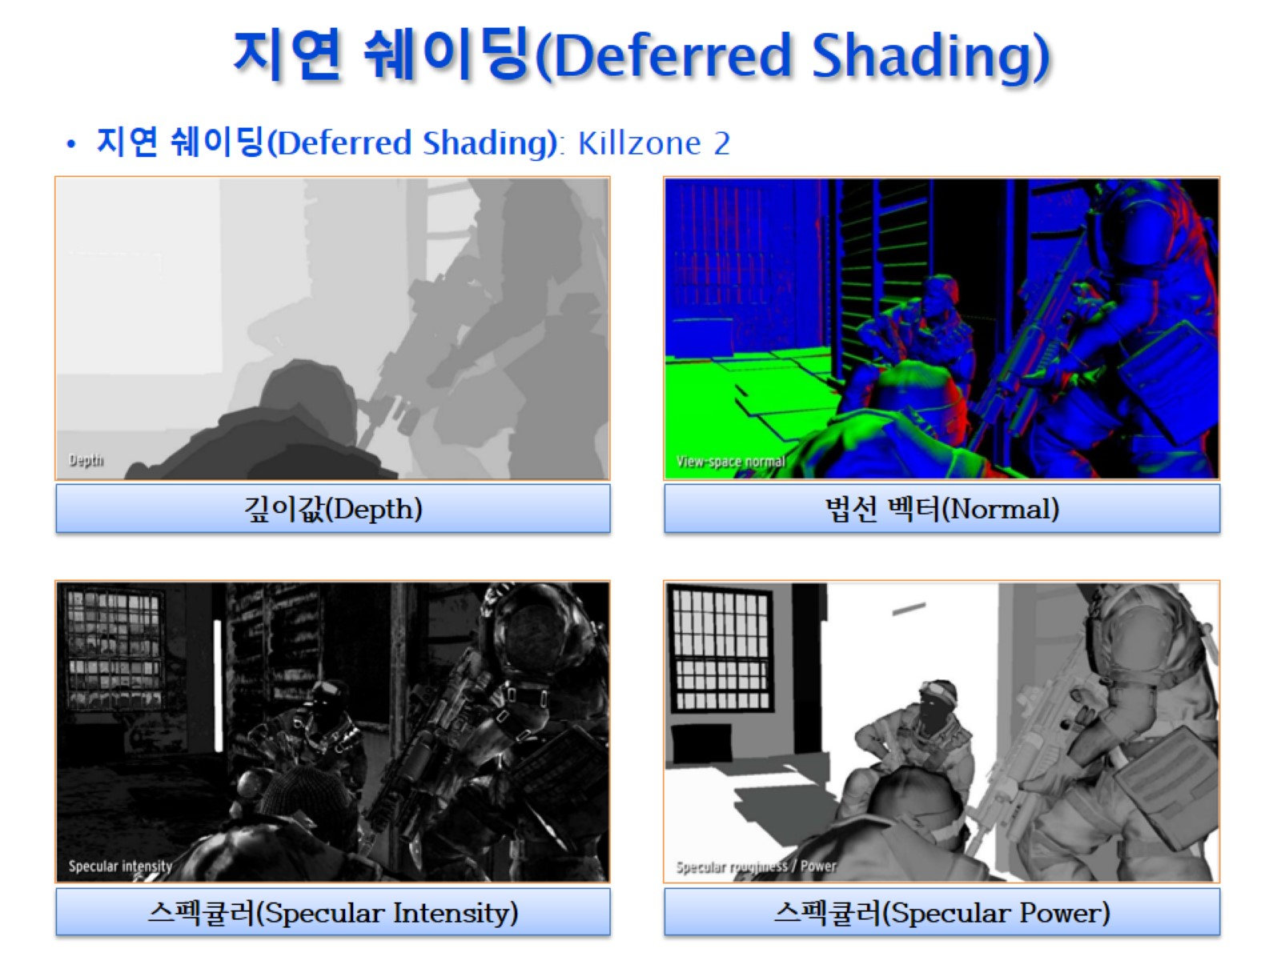
지연 쉐이딩(Deferred Shading)

Slide 7
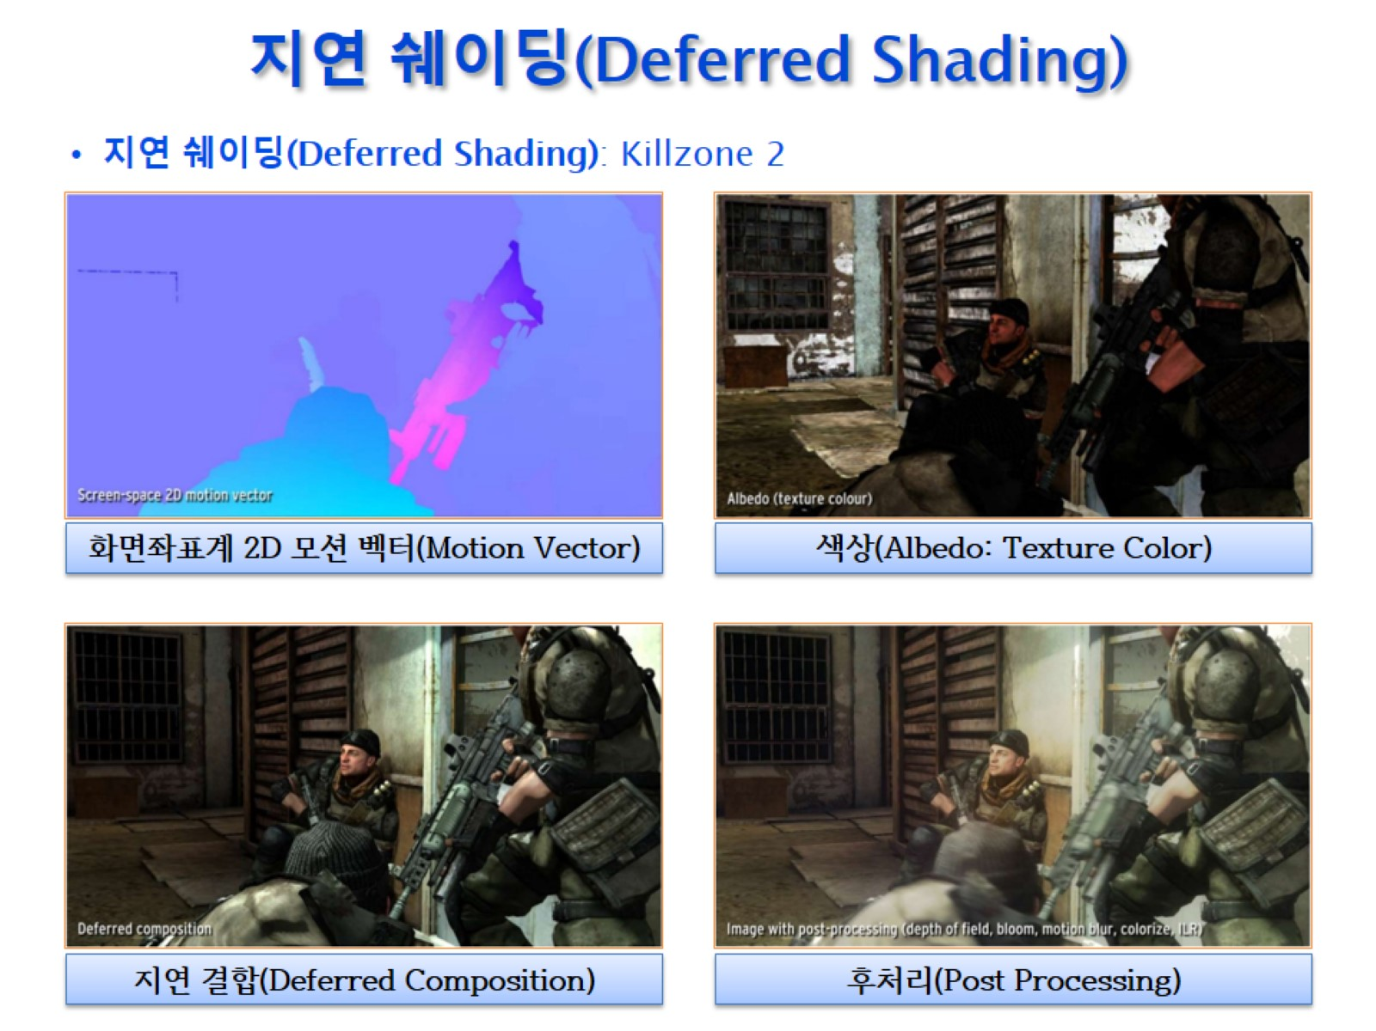
지연 쉐이딩(Deferred Shading)

Slide 8
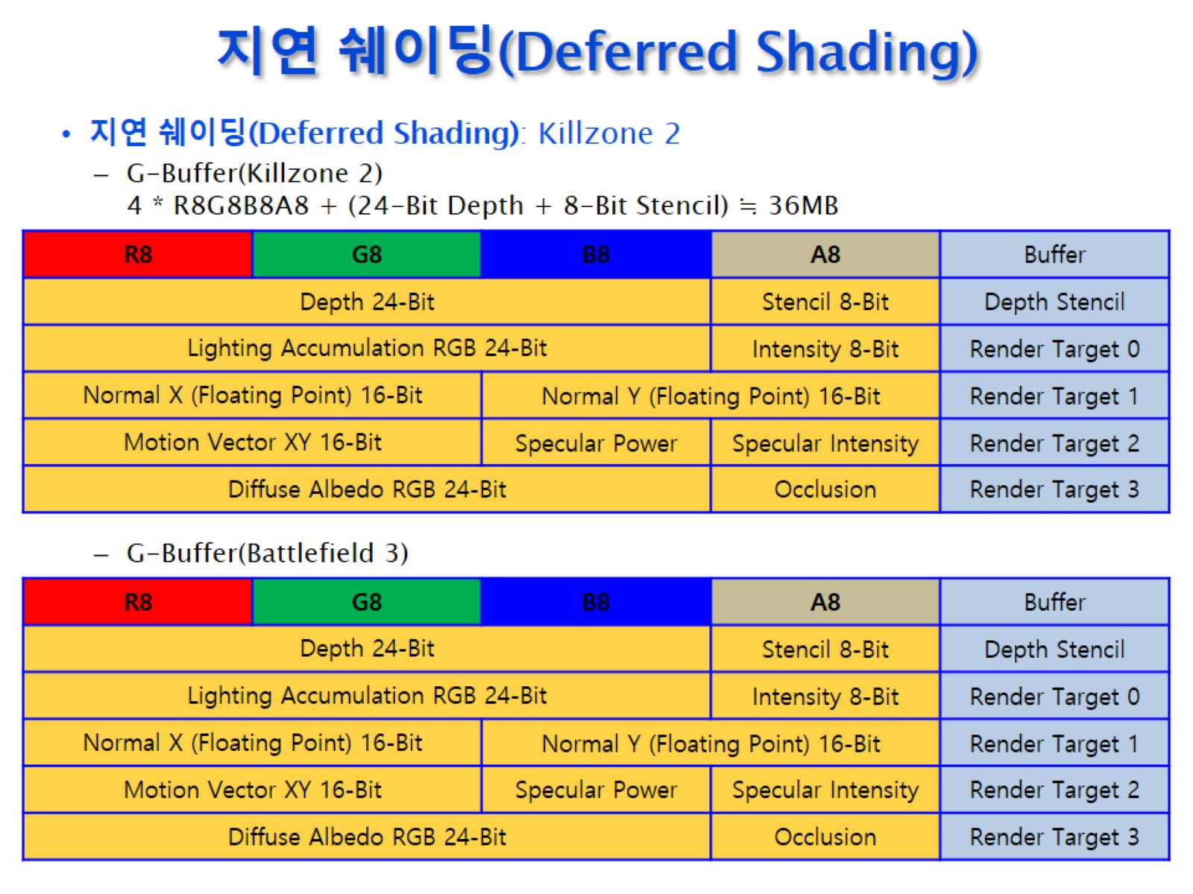
지연 쉐이딩(Deferred Shading)

Slide 9
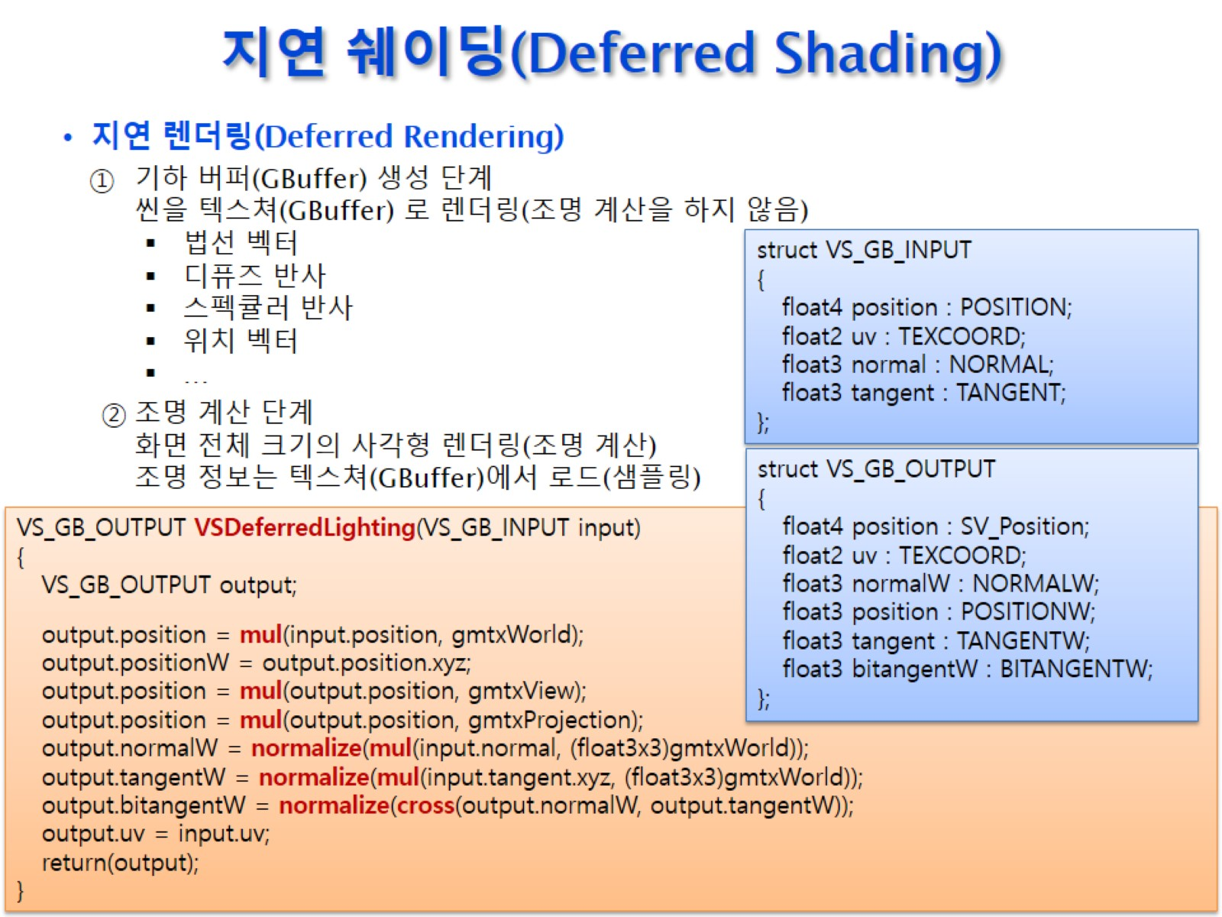
지연 쉐이딩(Deferred Shading)

Slide 10
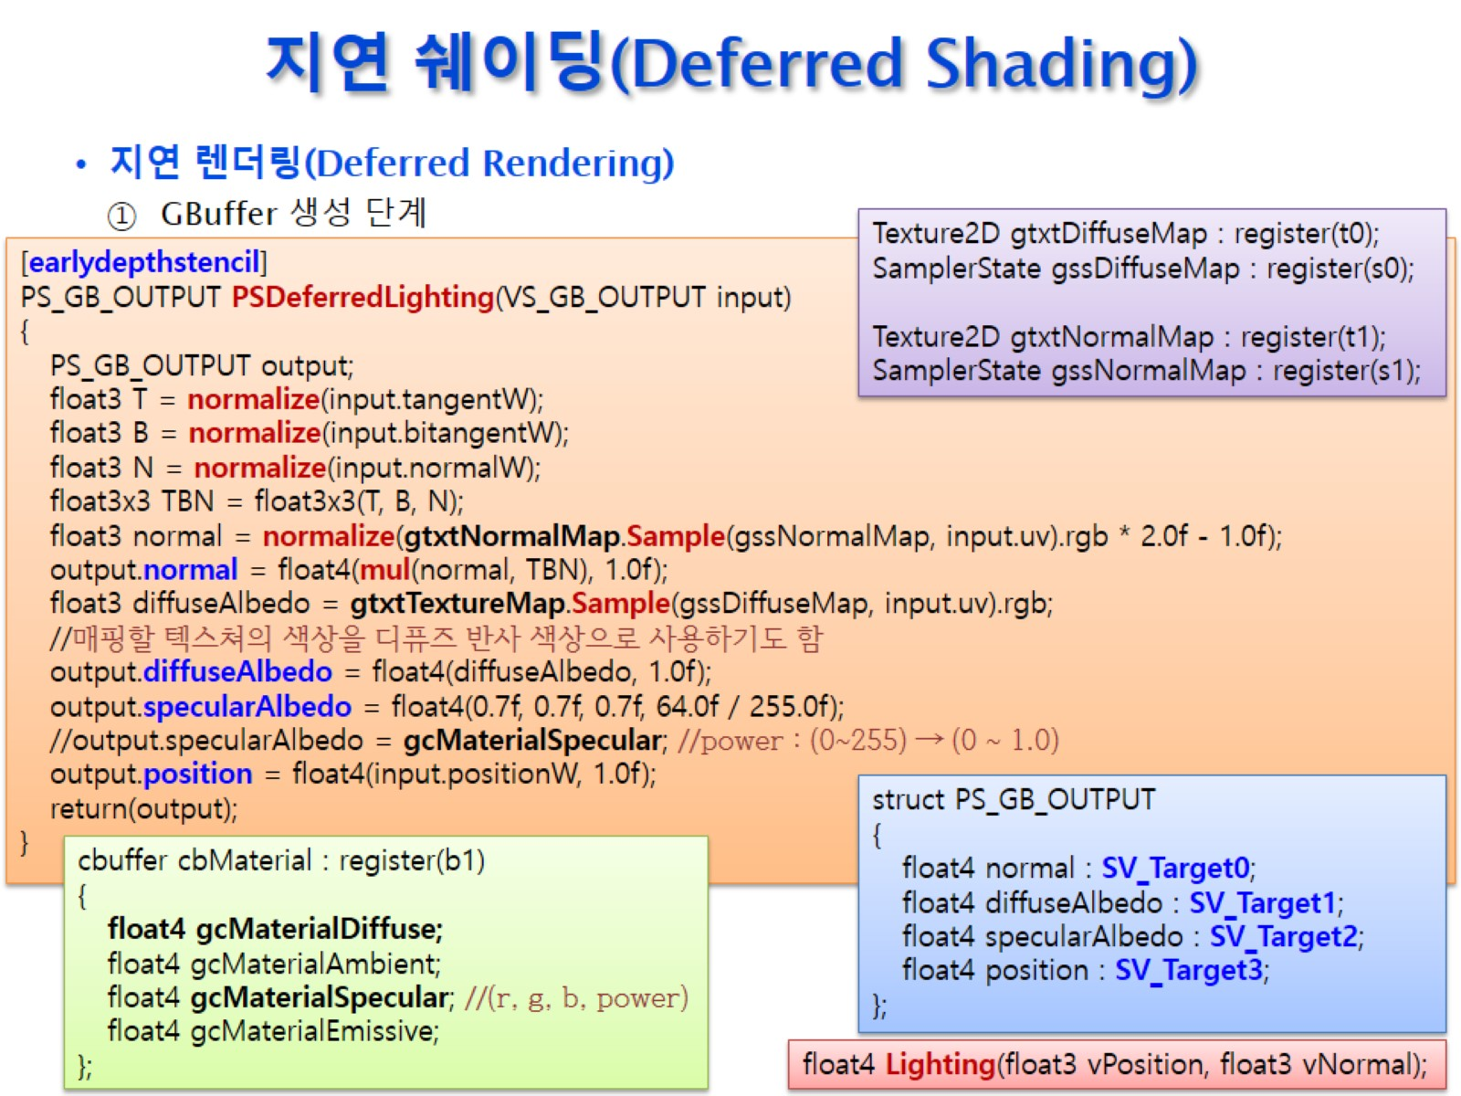
지연 쉐이딩(Deferred Shading)

Slide 11
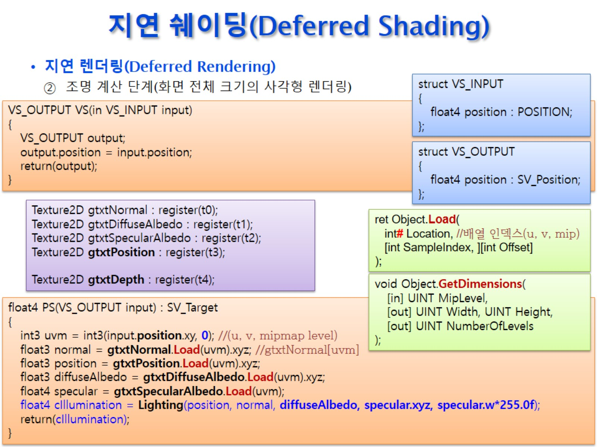
지연 쉐이딩(Deferred Shading)

Slide 12
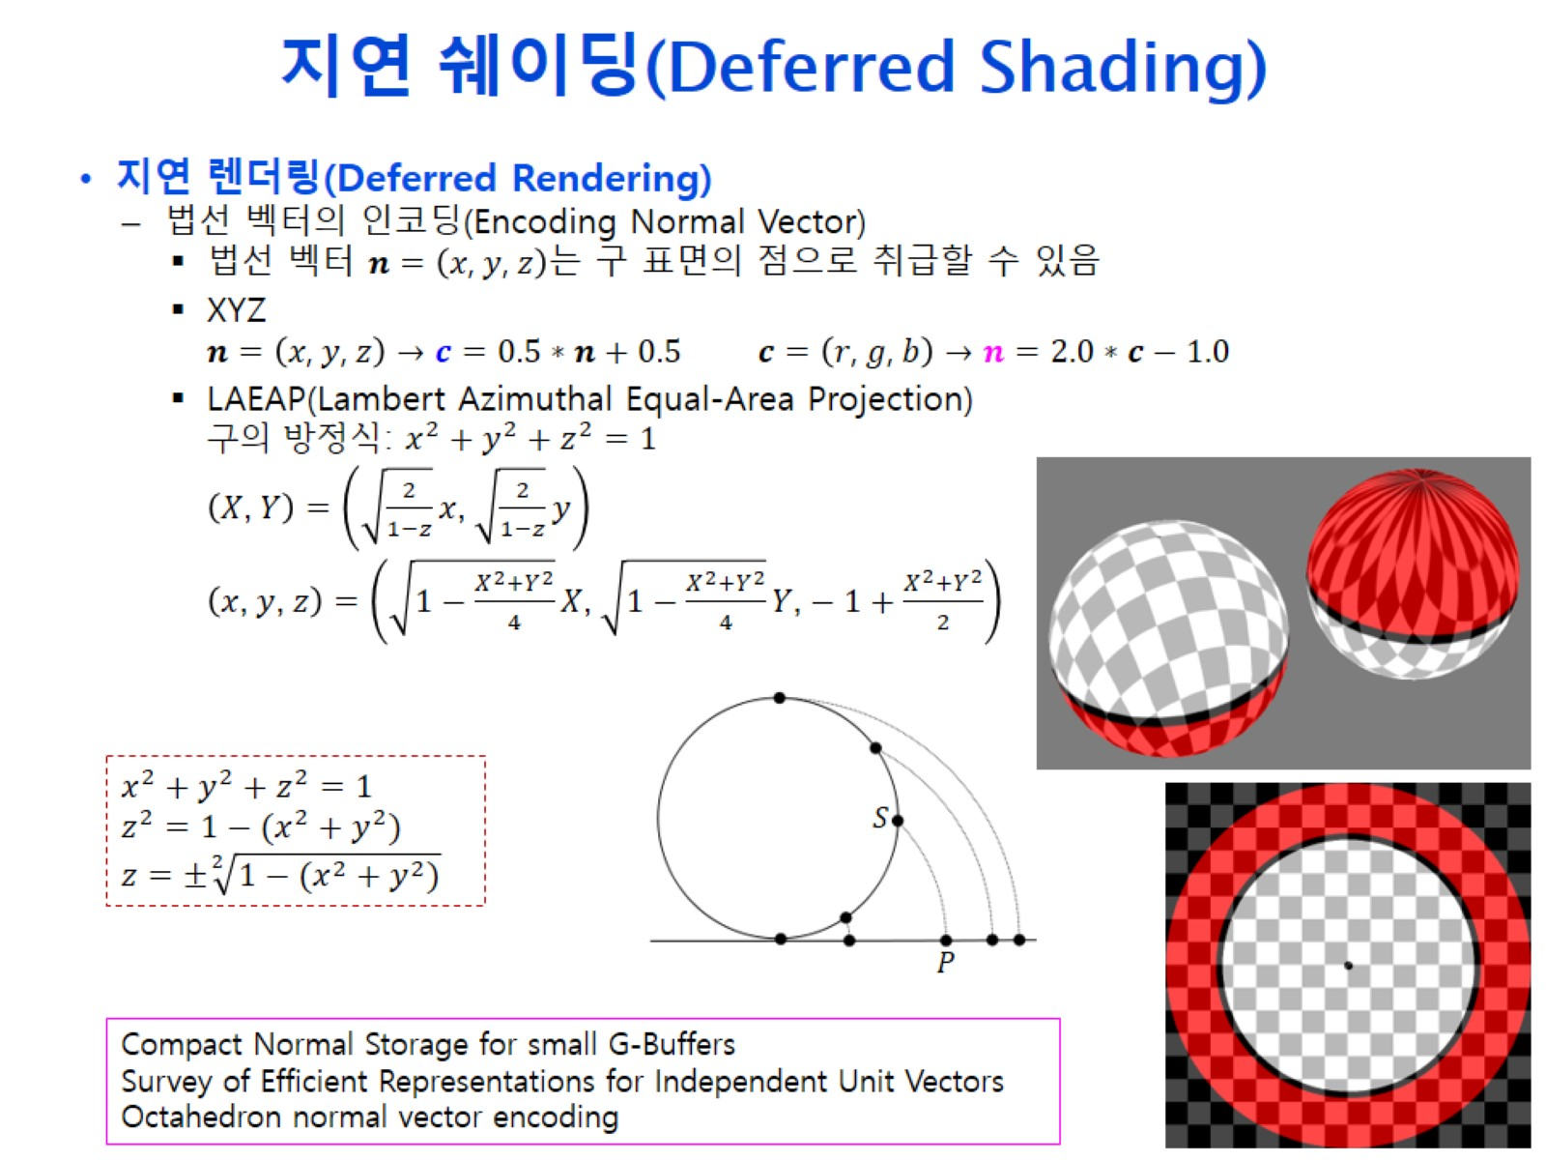
지연 쉐이딩(Deferred Shading)

Slide 13
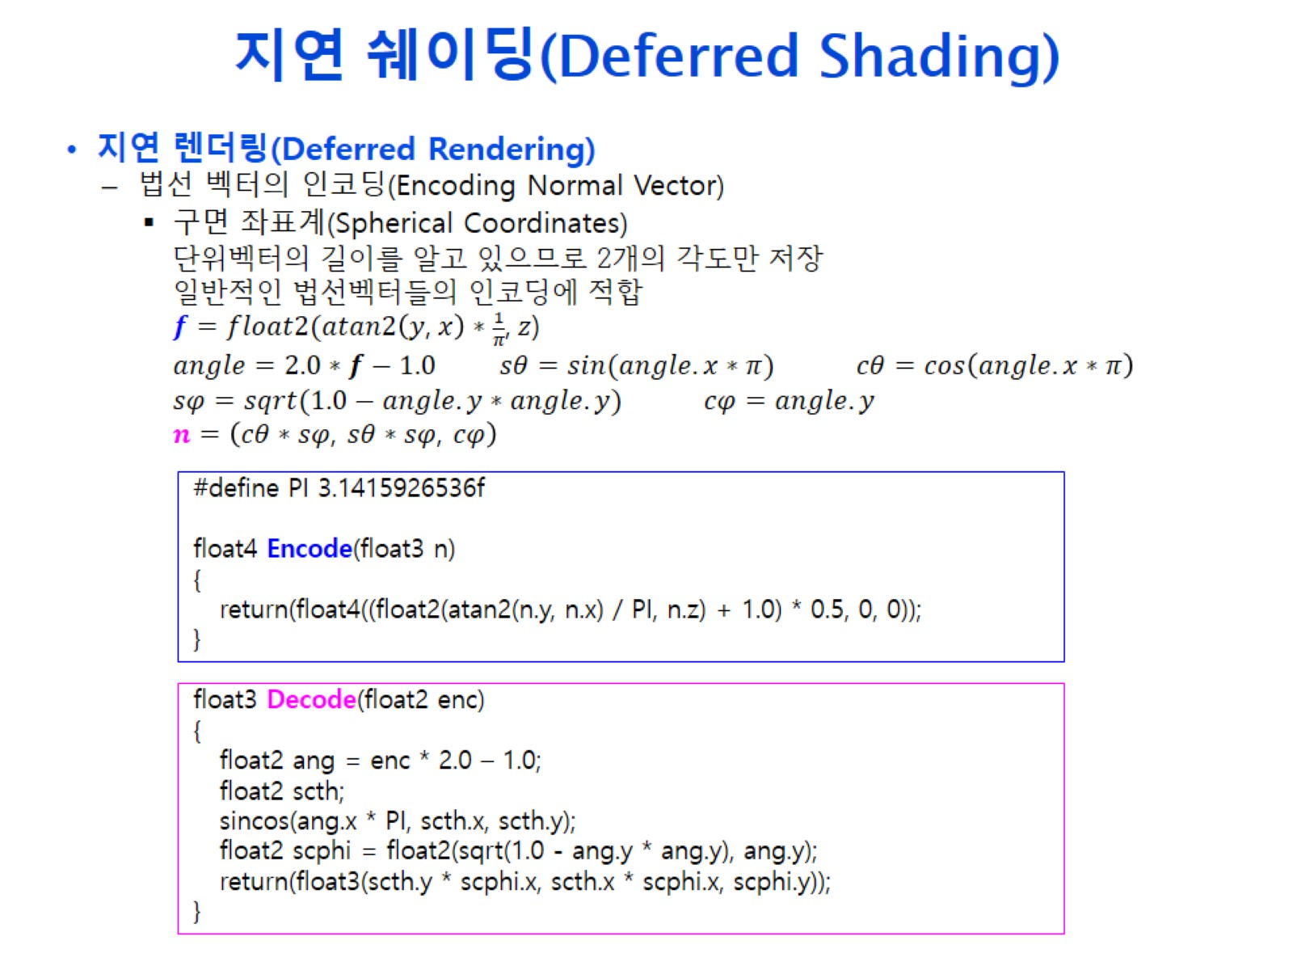
지연 쉐이딩(Deferred Shading)

Slide 14
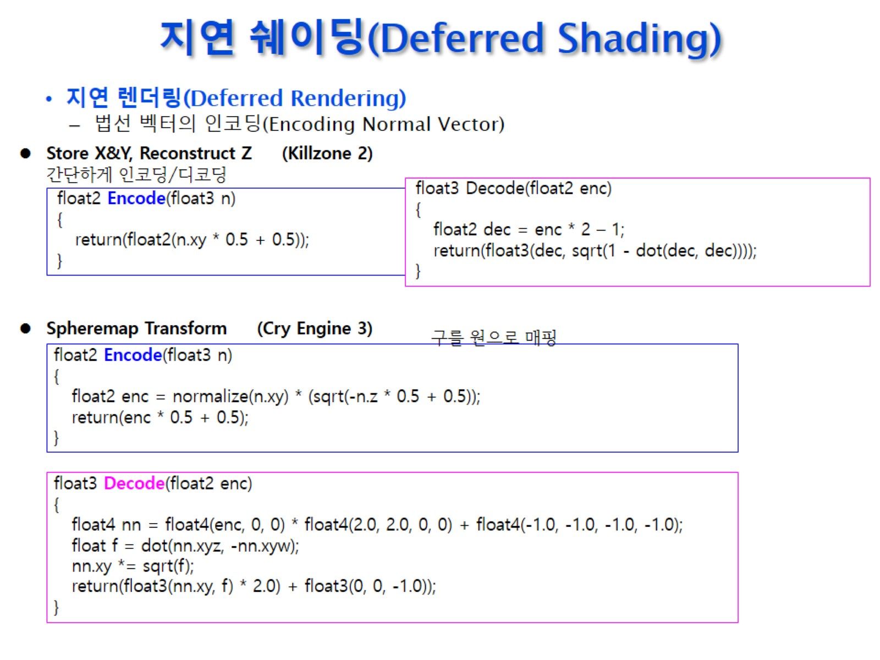
지연 쉐이딩(Deferred Shading)

Slide 15
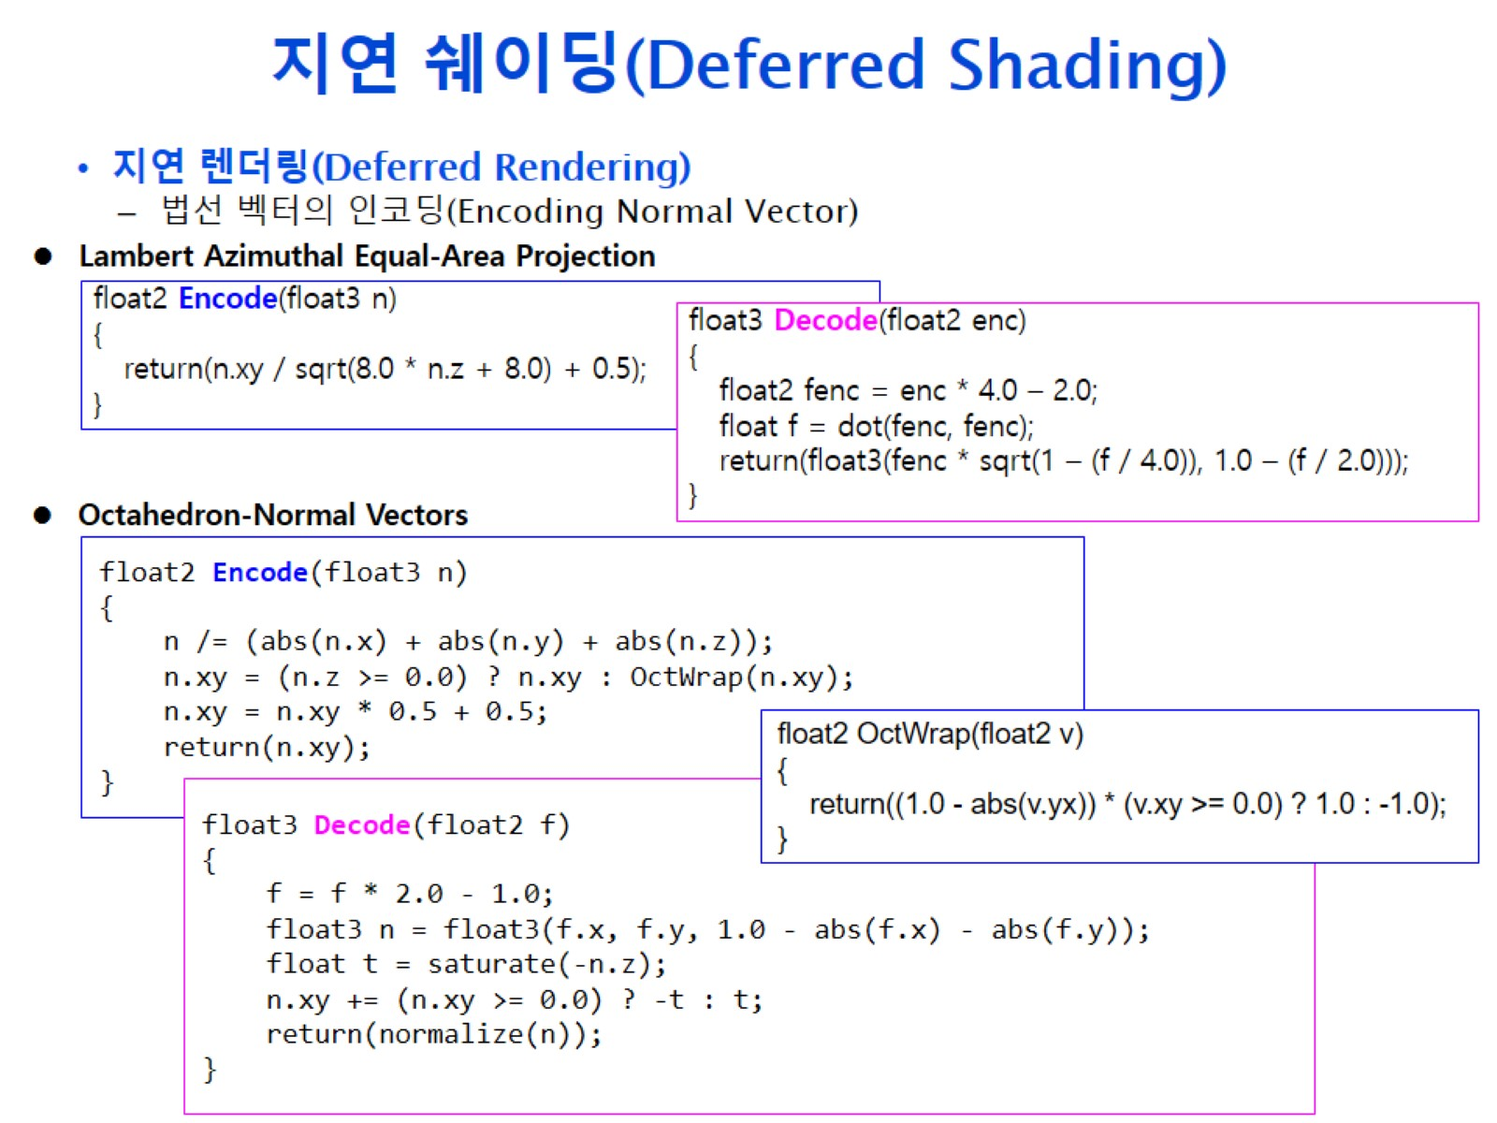
지연 쉐이딩(Deferred Shading)

Slide 16
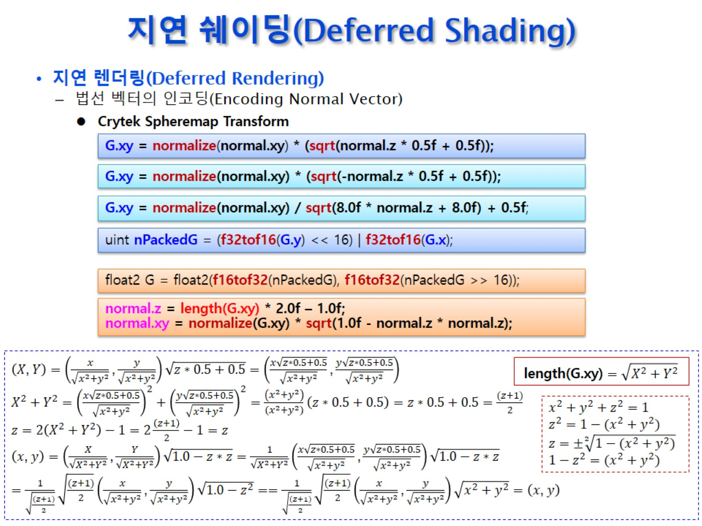
지연 쉐이딩(Deferred Shading)

Slide 17
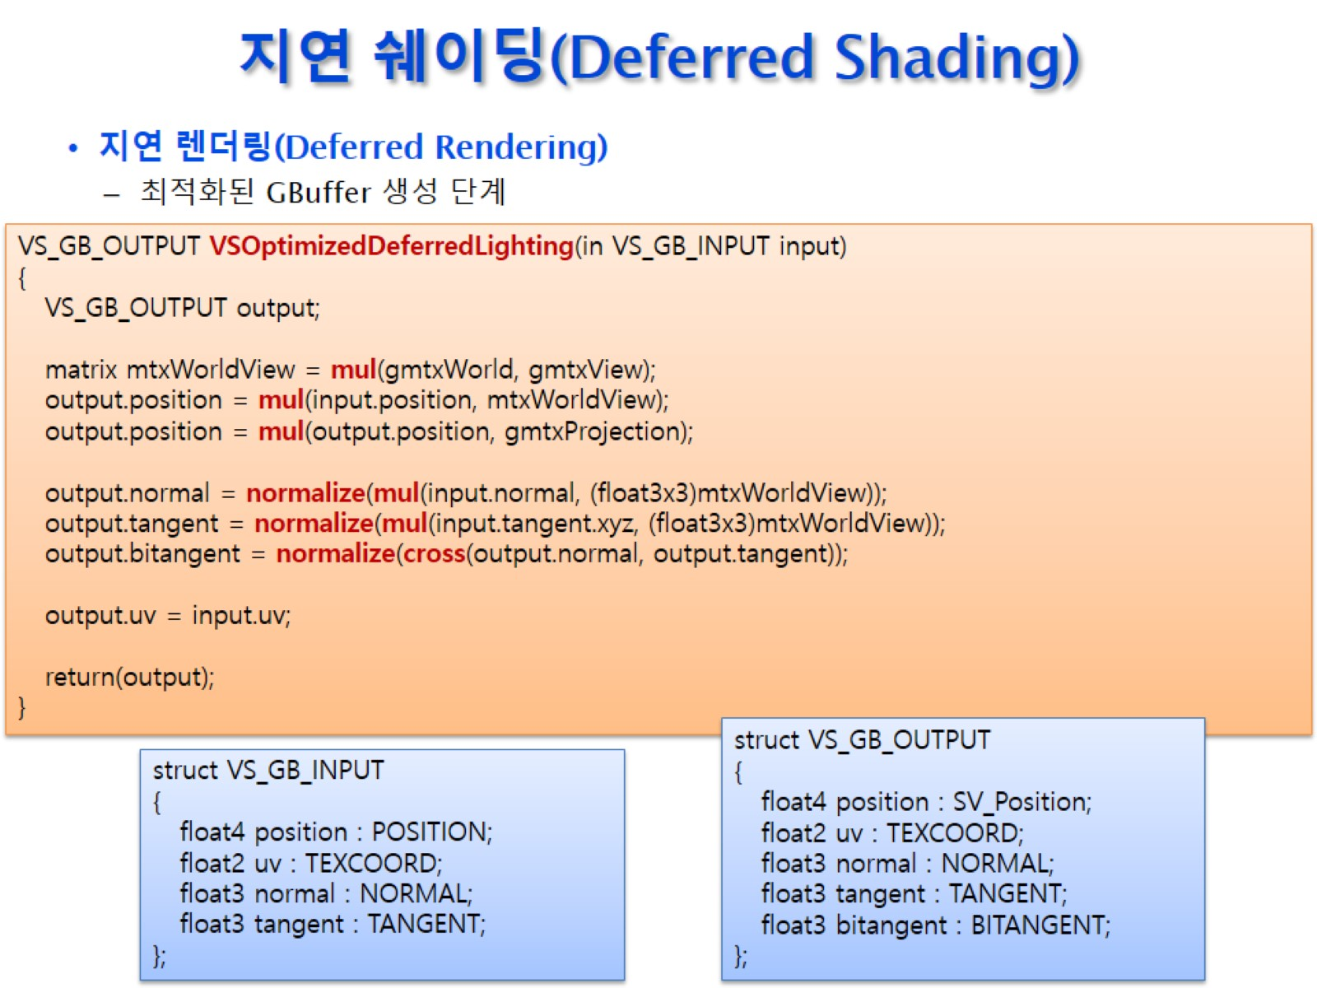
지연 쉐이딩(Deferred Shading)

Slide 18
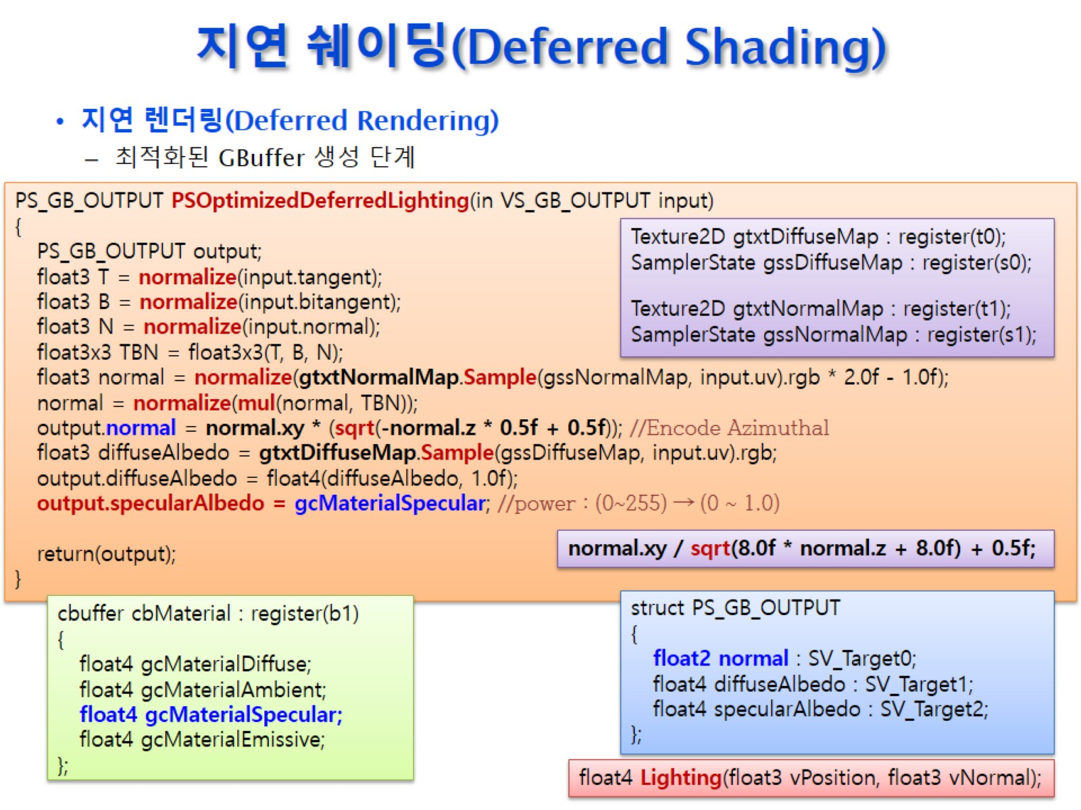
지연 쉐이딩(Deferred Shading)

Slide 19
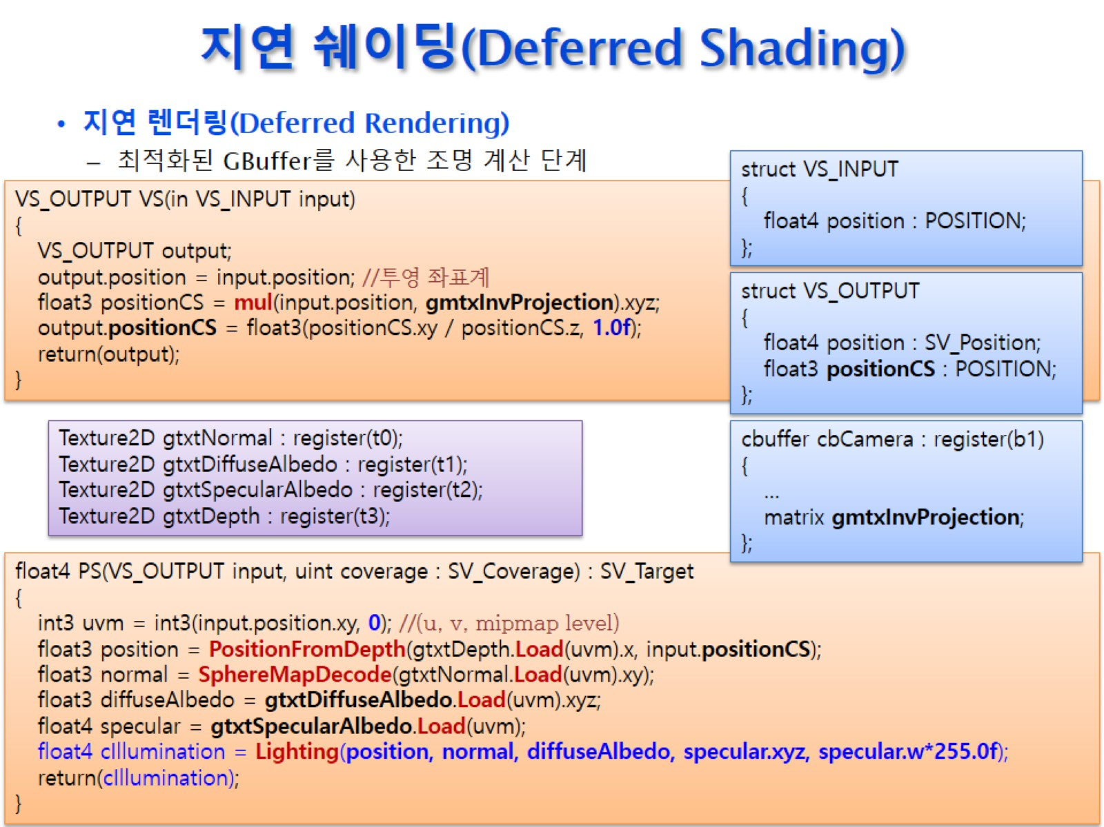
지연 쉐이딩(Deferred Shading)

Slide 20
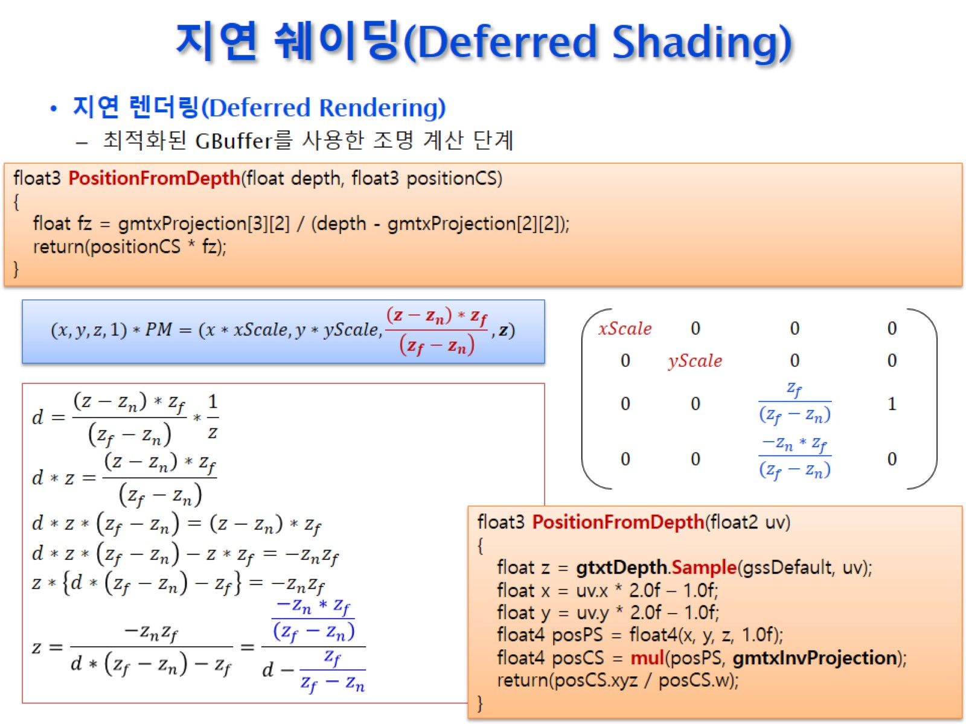
지연 쉐이딩(Deferred Shading)

Slide 21
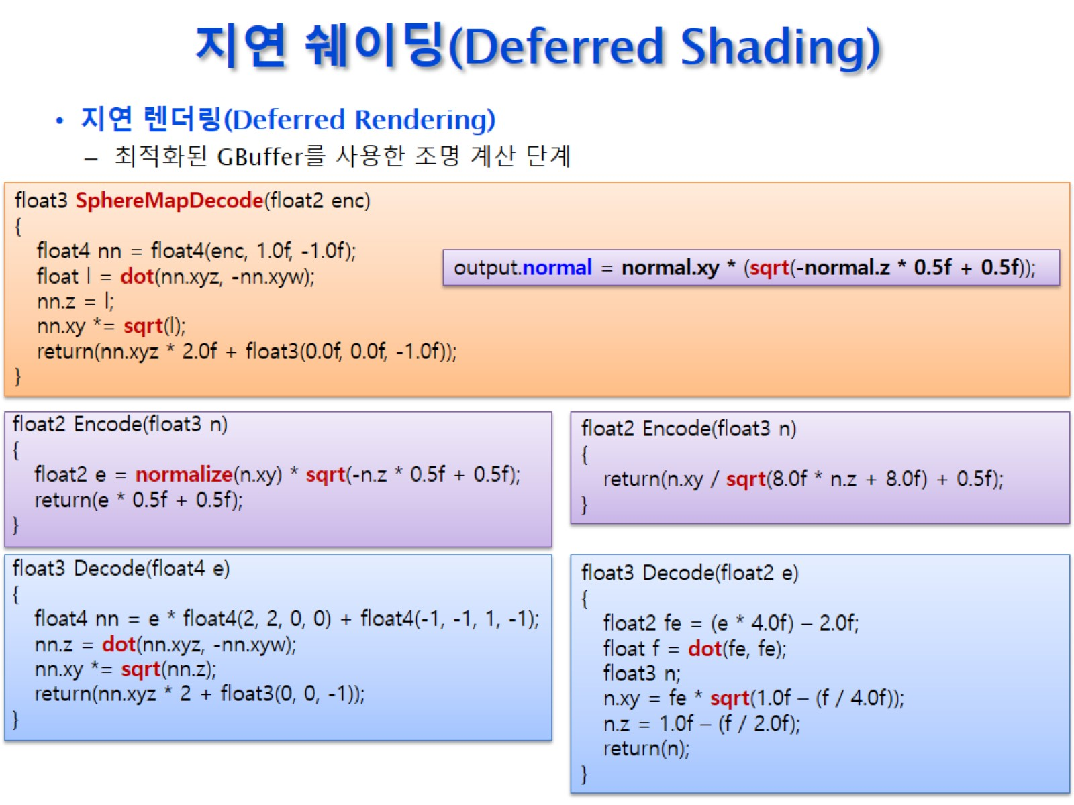
지연 쉐이딩(Deferred Shading)

